Slide 1
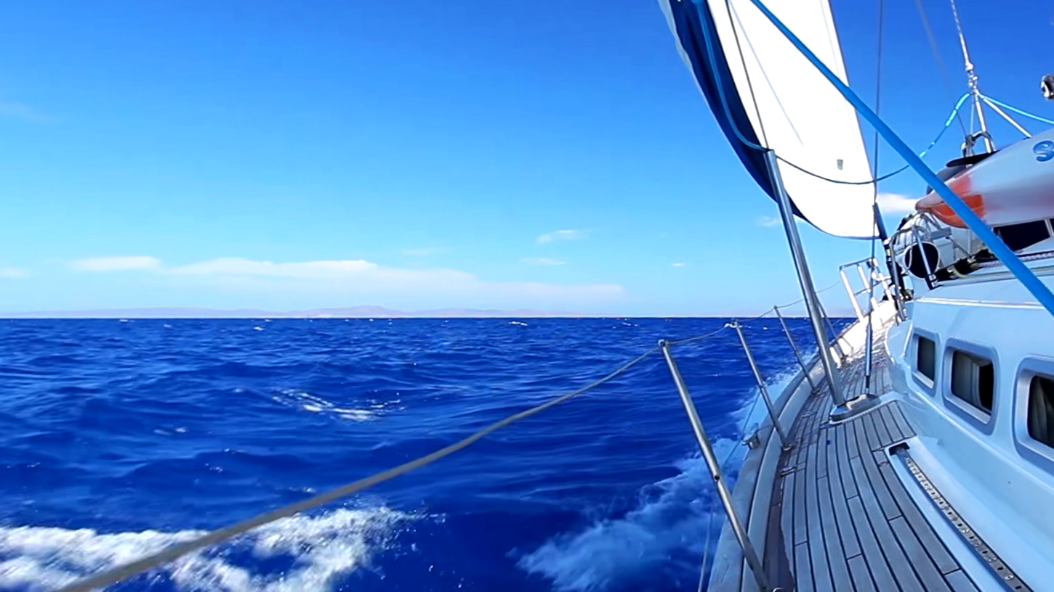





API Design Bootcamp | Week 6 | Stretch Goal
Anti-Corruption Layer
Notes:
[Sources]
- docs/Syllabus.docx
- Local bootcamp repository.
[Timing] 0:30
Introduce this as a focused stretch topic for the Week 6 Q&A and working session. The central question is: how do we integrate another system without adopting its model?

Slide 2
External systems bring their own language
The provider describes its world—not the domain model we designed.
VOCABULARY
SHAPE
LIFECYCLE
FAILURE
different names
different fields
different behavior
HTTP + vendor errors
Without translation, the external model spreads into our application.
Notes:
[Sources]
- docs/Syllabus.docx
[Timing] 2:00
Use a hypothetical D&D catalog provider. It may call a proficiency martial-melee, represent damage as 1d8, and communicate failures through HTTP. None of those details should automatically become domain concepts.

Slide 3
Direct integration gives another model control
WITH AN ACL
WITHOUT AN ACL
✓
Use application-owned interfaces
×
Inject HttpClient into use cases
✓
Translate external vocabulary
×
Pass vendor DTOs inward
✓
Isolate provider changes
×
Interpret provider strings everywhere
✓
Return domain concepts
×
Expose HTTP status codes
The application keeps its language when integration details stop at the boundary.
Notes:
[Sources]
- src/Zeal.Bootcamp.DnD.Application/Commands/CreateCharacter/CreateCharacterCommandHandler.cs
- src/Zeal.Bootcamp.DnD.Application/Services/Catalogs/IWeaponCatalog.cs
[Timing] 2:30
Contrast the dependency directions. The handler should ask for a weapon using an application capability; it should not know which provider, endpoint, DTO, or status code supplies it.

Slide 4
An ACL translates at the system boundary
EXTERNAL MODEL
OUR MODEL
Provider API
Client DTO
Translator
Domain object
HTTP • JSON • vendor vocabulary
Weapon • proficiency • damage
The adapter coordinates the call; the translator protects meaning.
Notes:
[Sources]
- Local bootcamp layered-architecture patterns.
[Timing] 2:30
Walk left to right. The client DTO is truthful to the provider. The translator is truthful to our model. The anti-corruption layer owns the difference between them.

Slide 5
The application owns the port
public interface IWeaponCatalog
{
// Evolved for external I/O
Task<Weapon> Find(string name);
}
internal sealed class CreateCharacterCommandHandler(
ICharacterRepository repository,
IClassCatalog classCatalog,
IWeaponCatalog weaponCatalog)
{
// The use case knows the capability,
// not the external provider.
}
PORT
Weapon
catalog
CAPABILITY
Find a domain weapon
CONSUMER
Command handler
OWNER
Application
Notes:
[Sources]
- src/Zeal.Bootcamp.DnD.Application/Services/Catalogs/IWeaponCatalog.cs
- src/Zeal.Bootcamp.DnD.Application/Commands/CreateCharacter/CreateCharacterCommandHandler.cs
[Timing] 2:30
This is the closest existing seam in the repository. The current catalog is local, but an external implementation can sit behind the same application-owned concept. A real network implementation would likely evolve Find to an asynchronous contract.

Slide 6
A complete ACL separates distinct jobs
internal sealed class ExternalWeaponCatalog(
IDndCatalogClient client,
IWeaponTranslator translator)
: IWeaponCatalog
{
public async Task<Weapon> Find(string name)
{
ExternalWeaponDto dto =
await client.GetWeapon(name);
return translator.Translate(dto);
}
}
The boundary contains:
✓
application port
✓
external client
✓
DTO + translator
✓
adapter + error mapping
Each part has one reason to change when the provider changes.
Notes:
[Sources]
- Hypothetical ExternalWeaponCatalog example based on the repository's IWeaponCatalog seam.
[Timing] 3:00
Define each role. The client speaks transport. The DTO mirrors the provider. The translator protects semantics. The adapter implements the application port and coordinates the pieces.

Slide 7
Translation protects domain meaning
public Weapon Translate(ExternalWeaponDto dto)
{
WeaponProficiency proficiency =
dto.Category switch
{
"simple-melee" =>
WeaponProficiency.Simple,
"martial-melee" =>
WeaponProficiency.Martial,
_ => throw new CatalogMappingException(
dto.Category)
};
return Weapon.Create(
dto.DisplayName,
proficiency,
Damage.Parse(dto.Damage));
}
EXTERNAL
DTO
DOMAIN
WEAPON
The translator owns the semantic decision.
Mapping is explicit so unknown external values cannot silently corrupt the domain.
Notes:
[Sources]
- src/Zeal.Bootcamp.DnD.Domain/Weapons/Weapon.cs
- src/Zeal.Bootcamp.DnD.Domain/Weapons/WeaponProficiency.cs
- Hypothetical ExternalWeaponDto and translation example.
[Timing] 3:00
Explain that translation is not property copying. It decides what an external category means in our language and rejects unknown meanings deliberately. Weapon.Create and Damage.Parse are illustrative extensions, not current repository members.

Slide 8
Failures must cross the boundary safely
try
{
ExternalWeaponDto dto =
await client.GetWeapon(name);
return translator.Translate(dto);
}
catch (ExternalNotFoundException)
{
throw new WeaponNotFoundException(name);
}
catch (ExternalPayloadException ex)
{
throw new CatalogUnavailableException(
"Weapon data could not be read.", ex);
}
Weapon not found
404
timeout
Catalog unavailable
bad data
Mapping failure
Transport details become application-level outcomes before they travel inward.
Notes:
[Sources]
- Hypothetical integration error types for teaching purposes.
[Timing] 2:00
Successful values are not the only translation. Convert external failures into stable application language, preserve the original cause for diagnostics, and avoid leaking status codes into domain behavior.

Slide 9
Not every mapper is an anti-corruption layer
API MAPPING
HTTP contract → use case
presentation boundary
REPOSITORY
domain ↔ persistence
data boundary
ACL
external model → our model
semantic boundary
HELPER
reusable transformation
no model ownership
An ACL is defined by the model it protects—not by the presence of a mapping method.
Notes:
[Sources]
- docs/Week 4 - Presentation Layer.pptx
- docs/Week 5 - Data Layer.pptx
[Timing] 2:00
Compare the boundaries students have already learned. All can contain mapping, but only the ACL prevents a separate model or bounded context from redefining our language.

Slide 10
Stretch goal: protect an integration
Integrate a provider without letting its DTOs or transport types travel inward.
01
Define the port
Describe the capability in application language.
02
Create the client
Keep HTTP and provider DTOs at the edge.
03
Translate meaning
Map values and failures into application concepts.
04
Replace the provider
Verify the use case and domain do not change.
Final test: if the provider changed tomorrow, how far would the change spread?
Notes:
[Sources]
- docs/Syllabus.docx
- src/Zeal.Bootcamp.DnD.Application/Services/Catalogs/IWeaponCatalog.cs
[Timing] 1:30
Close with the exercise. The desired answer to the final test is: the client, DTOs, translator, adapter, and registration change; the use case and domain remain stable.

